Slide 1
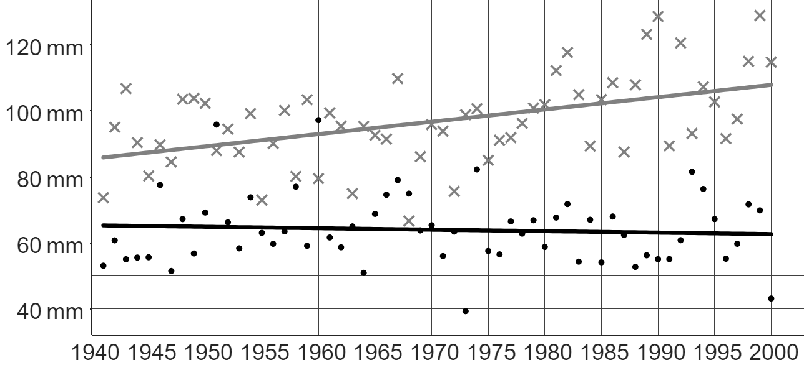
Studying local climate change
Task A: Analysing local climate data
1) This graph from the Met Office shows the average monthly rainfall (in mm) each year from 1941 to 2000 in Stornoway and Southampton.
Key:
Stornoway
Southampton
Andeep says: “We usually expect to see more rain falling each month in Stornoway than in Southampton.”
a) Explain how Andeep might have come to this conclusion.
b) In 1968, more rain fell in Southampton than in Stornoway. Explain whether this makes Andeep’s claim incorrect or not.
Sofia says: “Over time, the general trend in Stornoway is that the average amount of rainfall is increasing.”
c) Sofia is correct. Explain how Sofia might have come to this conclusion.
d) Write a sentence describing the long-term trend of Southampton’s rainfall.
Izzy says: “Stornoway is in Scotland. That means the amount of rainfall in other parts of Scotland is also increasing over time.”
e) Explain whether Izzy’s statement is correct or not.

Slide 2
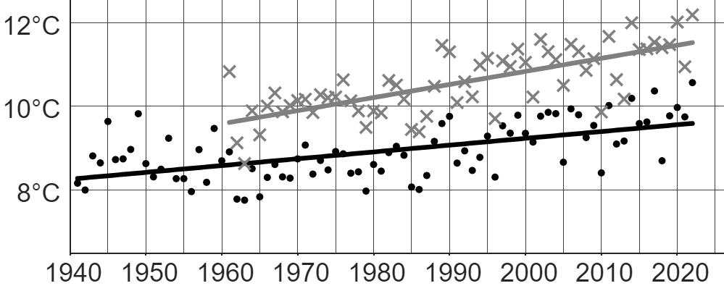
Studying local climate change
Task B: Forming conclusions about local climate change
1) This table from the ONS shows the distance people in the North-East and South-East of England travelled to work each day in 2011.
 | distance (d), in km
 | d < 2 | 2 ≤ d < 5 | 5 ≤ d < 10 | 10 ≤ d < 20 | 20 ≤ d < 30 | 30 ≤ d < 40 | 40 ≤ d < 60 | d ≥ 60
North East | 202 172 | 235 849 | 220 617 | 192 451 | 55 976 | 20 205 | 15 795 | 33 880
South East | 706 167 | 688 146 | 604 950 | 582 465 | 301 705 | 156 951 | 168 384 | 169 351
a) How many people’s information from the North-East were collected for this survey?
b) What fraction of people in the South-East travel under 10 km each day to work?
c) One possible influence on the climate of an area is the amount of carbon emissions (linked with travelling longer distances).
In which location (North-East or South-East) does a higher percentage of people travel 20 km or further each day to work?
2) This graph shows data from the Met Office on the mean yearly temperature for two UK locations: Manston (1961 – 2022) and Durham (1941 – 2022).
Key:
Manston (South-East England)
Durham (North-East England)
The long-term trends of both Manston and Durham are similar. Both locations show an increase in mean yearly temperature over time.
In which location is the mean yearly temperature increasing at the faster rate? Explain how you know.

Slide 3
Studying local climate change
3) This graph shows data from the Met Office on the mean yearly temperature for two UK locations: Manston (1961 – 2022) and Durham (1941 – 2022).
Key:
Manston (South-East England)
Durham (North-East England)
a) Using both your answers to question 1c and 2, write down a possible link between distance travelled to work and mean yearly temperature.
b) Explain the extent to which this link is accurate or not by assessing the validity of the
comparisons across both sets of data.
Mathematics in Education and Industry
v2.4

